Slide 1
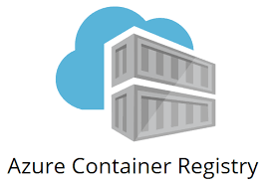
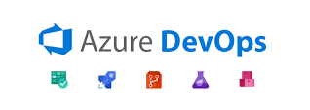
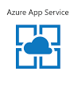
Consult Cloud Hackathon DevSecOps Hackathon – Nov 2024
TEAM 7
22nd November 2024

Slide 2
DevSecOps Hackathon – Nov 2024
Team Members
 | Name
01 | Babu Thangaratinam
02 | Govardhana Reddy
03 | Kempana Karajol

Slide 3
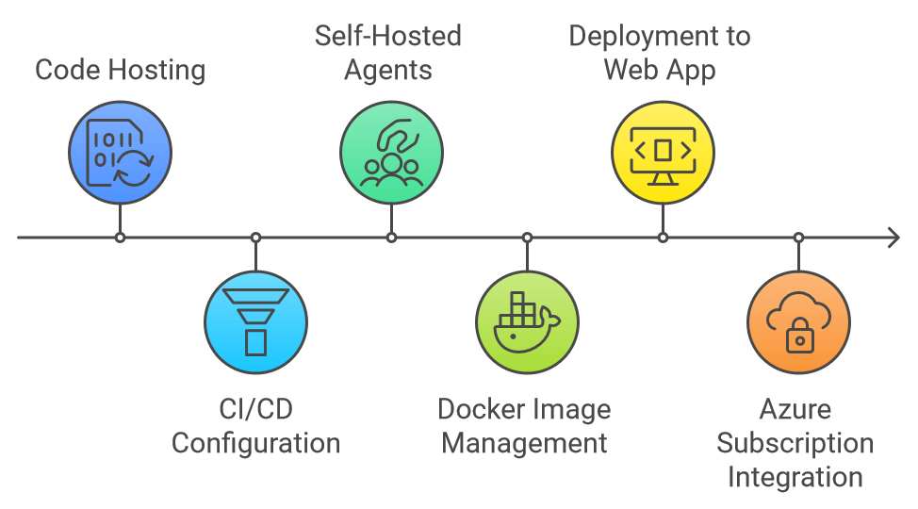
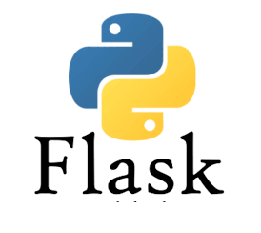
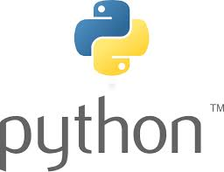



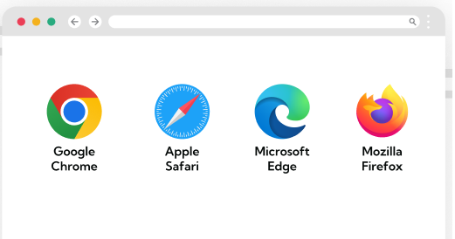
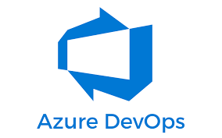

Process Flow

Slide 4
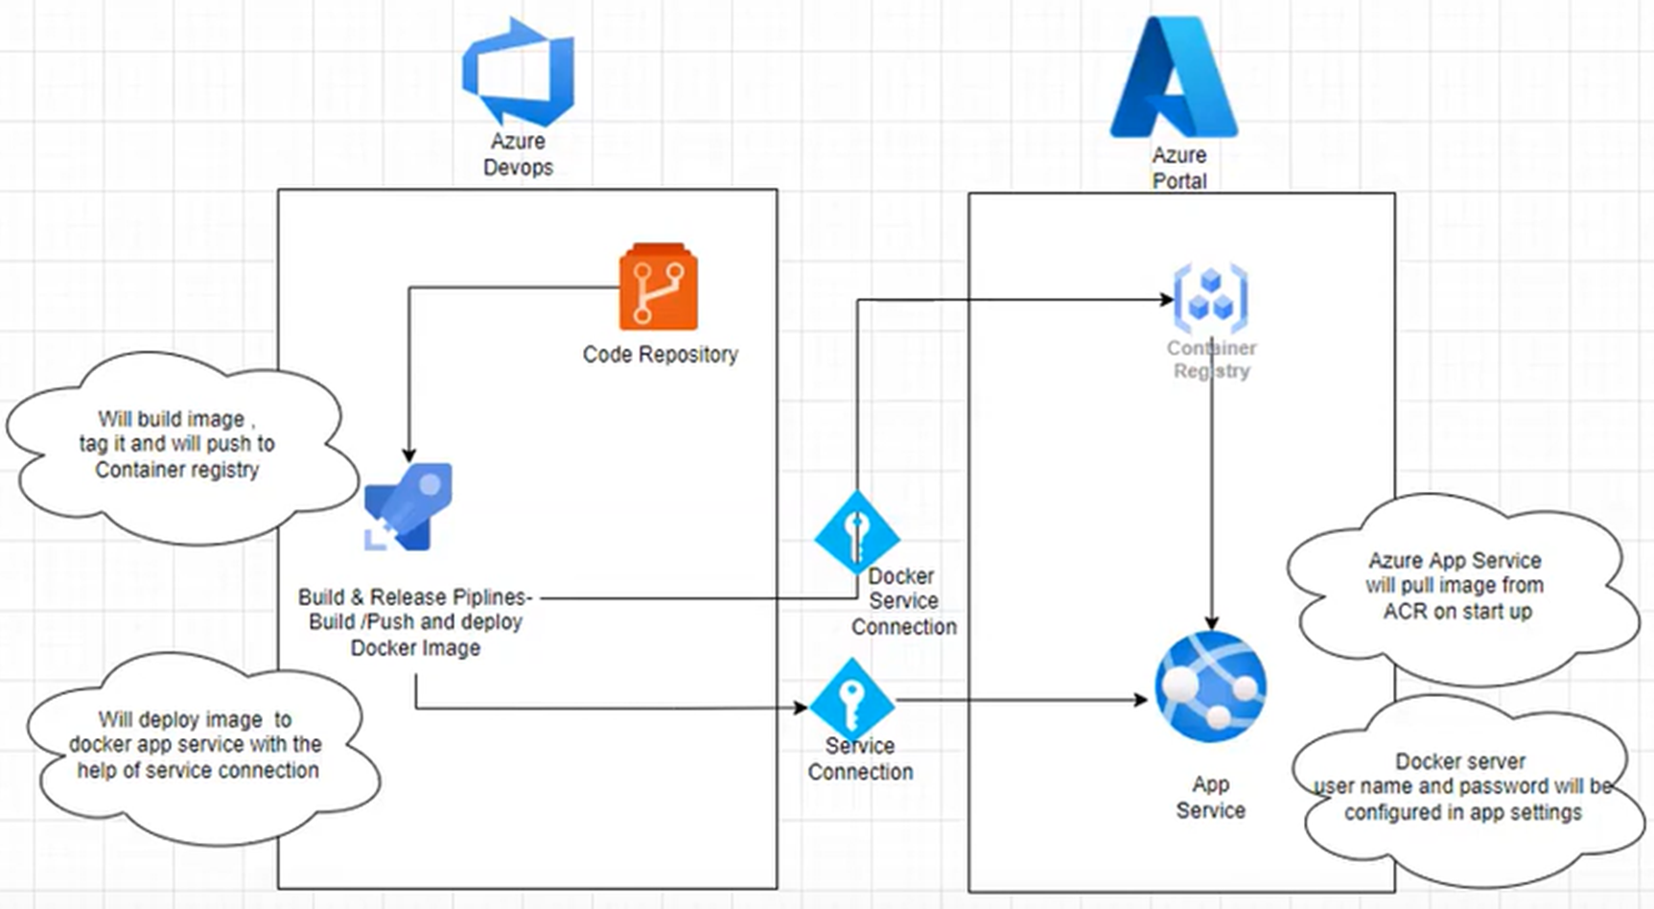
Architecture Diagram

Slide 5
Overview of Implementation Plan:
STAGES | TOOLS USED
Repository | Azure Devops Repo
CI/CD Pipeline | Azure Devops Pipeline
Agents | Azure Devops Self-Hosted Agents
Container Registry | ACR (Azure Container Registry)
App. Server | Azure App Service (Webapp)
Cloud | Azure
1. Code Hosting
Azure DevOps Repo is used as the central repository for source code management.
2. Continuous Integration/Continuous Deployment (CI/CD)
CI/CD pipelines are configured in Azure DevOps.
Pipelines automate the process of:
Code build and testing.
Deployment across environments.
3. Self-Hosted Agents
Self-hosted agents linked to Azure DevOps using PAT (Personal Access Tokens).
Custom agent pools configured for pipeline execution.
4. Docker Image Management
Docker images are built within CI pipelines.
Built images are uploaded to Azure Container Registry (ACR).
5. Deployment to Web App
Applications are deployed to a cloud-hosted Alpine Linux-based Web App/App Service.
Lightweight and optimized runtime environment.
6. Azure Subscription Integration
Azure DevOps connects to Azure subscriptions via Service Connections.
Secure integration for managing resources and deployments.

Slide 6
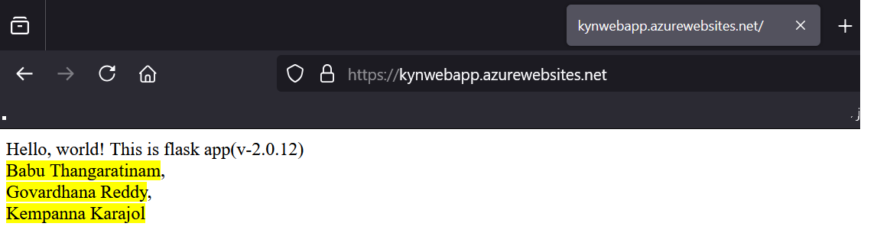
Output

Slide 7
DevSecOps Hackathon – Nov 2024
Week-1 (4 days)
Statement-1
Build a web application with a home page that can have the team member names with Green background on a Linux docker image. Export the docker image to a container registry.
Statement-2
A start-up company in Belgium would like Kyndryl consulting team to showcase our DevOps capability. Kyndryl cloud consultants are tasked to create a cost effective PoC environment with devops tool chain (maximize the use of available tools within Kyndryl) that enables seamless management of DevOps processes across multiple cloud platforms (e.g., AWS, Azure, Google Cloud) in the future. The scope is limited to create a CI pipeline where the team need to build container image and export it to a container registry. Ensure the toolchain design support building CI/CD pipelines for IaC and applications and easily extensible to accommodate SecOps components in the future.
During the assessment session (15 minutes) per tea, the judges will ask few random questions and each of the team to demonstrate their container skills. Below are few sample questions.
Run the docker image on a Linux VM
Update the web page with Red background
Demonstrate how to run a docker image on a Linux VM and changing port numbers, detach mode, specific version of the container image etc.,
Change the version of the application (ex: Nginx version 1.26.2 to 1.24.0)
How to improve the speed of continuous integration?
Trigger integration based on commit to a particular branch

Slide 8
Success Criteria:
Statement-1
Team should successfully build docker images and run it. Also they should demonstrate the tasks that are requested by the judges during the assessment session
Run the docker image on a Linux VM
Update the web page with Red background
Demonstrate how to run a docker image on a Linux VM and changing port numbers, detach mode, specific version of the container image etc.,
Statement-2
Team should able to show the container images can be build on stored on a container registry via a CICD pipeline. There is no requirement for deploying the container image to a Kubernetes cluster but atlease the team should demonstrate building and uploading the container image from the Git (code) to a image on a registry.
How to improve the speed of continuous integration?
Trigger integration based on commit to a particular branch

Slide 9

Judging Criteria:
Week-1/
Category | Weightage | Scores | Judge-1 | Judge-2
Demonstration of Docker image build and run time skills | 20% | 0-20
Change the version of application version and run the container | 20% | 0-20
Explaining (the continous integration) how docker images get created and exported to Registry | 20% | 0-20
Demonstrate building images via Pipeline | 30% | 0-30
List down all the docker images (running as well stopped instances) | 10% | 0-10
Total |  | 0-100 | 0 | 0

Slide 10
Thank you

